Slide 1




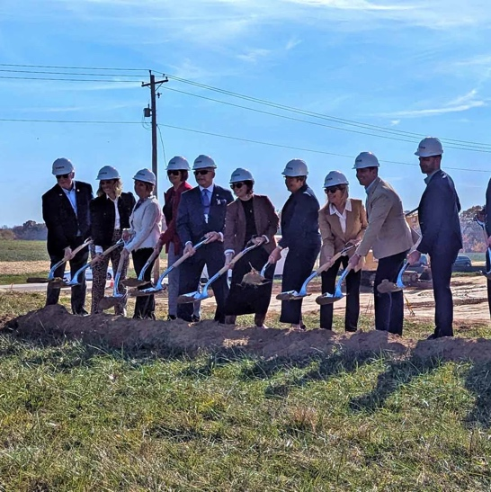
Annual Course of Study in Ethics for the Directors, Officers, and Staff
August 27, 2025

Slide 2
Overview of the Annual Course of Ethics
  For Board Members
Standards of Conduct
Conflicts of Interest
Gift Policies
Governance / Fiduciary Duties
  For Employees
Standards of Conduct
Conflicts of Interest
Gift Policies
Governance / Fiduciary Duties
Whistleblower Policy
Political Activity & Lobbying
Project Confidentiality
Insider Training
Sexual Harassment
2

Slide 3
Standards of Conduct

Slide 4
We Must:
All board members and employees shall strive for the highest ethical conduct and fundamental honesty. At all times we must:
  perform our duties in good faith
  in a manner reasonably believe to be in the best interest of JO
  with the care of an ordinarily prudent person in a like position under similar circumstances
  maintain the confidentiality of all JO and customer information
4

Slide 5
We Must Never:
Deceive, defraud, or mislead anyone connected to JO
Misrepresent JO in negotiations, dealings, or contracts
Divulge / release confidential or proprietary JO information
Obtain / seek a personal advantage or benefit from relationships established by your position at JO
Withhold your best efforts to perform your duties
Engage in unethical business practices
Use JO property, financial resources / services of JO for personal benefit
Violate any applicable laws or ordinances
5

Slide 6
Conflict of Interest

Slide 7
Financial & Fiduciary Interests
Financial Interest
  A financial ownership or investment interest between an employee and any person or entity, such as:
    An equity interest in a non-publicly traded entity
    An equity interest of 1% or more of any publicly-traded company
    Income from intellectual property rights.
  This policy does not include an employee’s JO salary, pension, mutual funds or bank accounts.
Fiduciary Interest
  An obligation to act in the best interests (financial success) of another, such as membership on a Boarrd or management role in a company.
7

Slide 8
Disclosure Obligations
Formal: Per R.C. 187.03(B)(2): Directors and employees with significant administrative, supervisory, contracting, or investment authority as defined by JobsOhio must file a Financial Disclosure Statement annually
Informal: Anytime an employee is concerned about a Potential Conflict of Interest, contact General Counsel or the Managing Director, Enterprise Risk
8

Slide 9
Gift & Corporate Giving Policies

Slide 10
Gift Policy (received by JO employees)
Employees must follow the law when seeking or doing business with public officials.
Gift = ANYTHING of value that holds no expectation of receiving anything in return.
“Business Associate” = person / entity the employee interacts with on a professional basis (excludes employees and board members).
Employee may not solicit anything of value that could reasonably be expected to influence the employee in the performance of their duties.
10

Slide 11
Gift Policy (received by JO employees)
Consider the following when offered a gift:
  Was it given without an express or implied obligation?
  Does it violate law?
  Does it place you in a compromising position?
  Would an ordinarily prudent person in a similar position under similar circumstances believe it creates the impression of favoritism?
No cash ever! No gift cards over $35.
Circumventing the gift policy may result in disciplinary action
“Paying” less than FMV is an improper gift.
Understand the cumulative cost of a gift.
11

Slide 12
Corporate Giving Policy (given by JO employees)
Gift” and “Business Associate” definitions = Same as in Gift Policy
  Permissible Gifts:
    Small gift or token of esteem or gratitude
    Relevant connection to or made in Ohio
    Give openly and transparently
    Properly recorded in giver’s books
    Provide only to reflect esteem or gratitude
    Permitted under local law
12

Slide 13
Corporate Giving Policy (given by JO employees)
Permissible Amounts:
  <$75 No prior approval / corporate gift giving form
  $75 - $125 Supervisor approval & gift giving form
  $125 - $225 Leadership Team approval & gift giving form
  >$225 CEO approval & corporate gift giving form
Claudia gift approval for Foreign Nationals
If Business Associate cannot accept a gift, do not offer to staff / family
Cannot pay for gift personally
13

Slide 14
Governance

Slide 15
Governance Duties for Not-for-Profit Organizations
Duty of Care: Act in good faith, with the care an ordinarily prudent person in a like position would exercise under similar circumstances
Duty of Loyalty: Act in good faith in a manner you reasonably believe to be in or not opposed to the best interests of the organization
Duty of Obedience: Act within the organization’s purposes to further the mission of the organization, as well as seek to ensure compliance by the organization with applicable legal requirements
15

Slide 16
Approach To Satisfy The Duty of Care
Devote sufficient time to prepare for and attend meetings
Be alert to “red flags” – do not hesitate to raise questions
Discuss and deliberate significant issues
Decision making must be thorough
Reliance on management and experts must be reasonable
Ensure meetings and decisions are well-documented
Discuss important matters without management present
Tone at the top exhibit respectfulness and candor, diversity of opinion, and clear lines of authority
16

Slide 17
Approach To Satisfy The Duty of Loyalty
Avoid and disclose conflicts
Act in good faith
Hold corporate information in the strictest of confidence
Maintain transparency
Ensure independence
Situations that call into question one's duty of loyalty:
  A director appearing on both sides of a transaction
  A director receiving a personal benefit from a transaction
  A director usurping / appropriating a financial opportunity for personal gain
17

Slide 18
Approach To Satisfy The Duty of Obedience
Must always act within the organization’s stated mission
Dedicate the organization’s resources to its mission
Complying with all appropriate laws
Engage in prudent financial management
Maintain insurance and indemnification protections
Limitations on the mission can be found / monitored in the following:
  Organization’s Bylaws
  Tax exemption application (Form 1023)
  Annual Tax Return (Form 990)
  Agreements with client companies and vendors
18

Slide 19
Governance Duties
When operating as a Board, act as a whole and JO is 1st loyalty.
Board Member duties:
  Set the direction for the organization
  Decision making
  Oversight
  Mentorship
Per Ohio law, the Board Members can rely on:
  Officers and employees of the organization
  Legal Counsel
  Public Accountants
  Consultants or other professionals
  Committees of directors
19

Slide 20
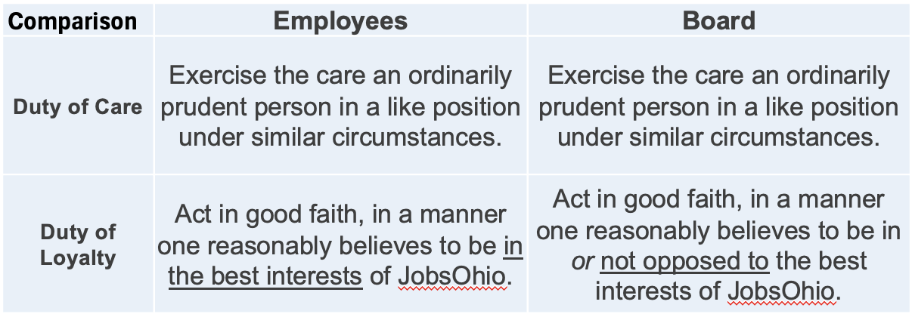
Governance Duties
Management & Employee duties:
  Provide input to help the Board give direction
  Execute direction given by the Board through the appropriate use of authority and observing set limits
20

Slide 21
Whistleblower

Slide 22
Whistleblower Policy
Purpose: Encourage employees to raise concerns
Expectation: Responsibility of all Directors, Officer and employees, to report policy and legal violations
  Required reporting for Managers
Retaliation: No harassment, retaliation / adverse consequences
  Good Faith v. Malicious / Knowingly False allegations
Open Door Policy:
  Your Manager
  Claudia, Sheila, or Don
  JO’s Hotline
Confidentiality: To the extent possible
  Highly-skilled, professionally trained corporate investigators
22

Slide 23
Political Activity &
Lobbying

Slide 24
Permissible Political Activity
  Vote!!
  Work at the polls! (with supervisor approval)
  Volunteer non-working time and personal resources to support non-partisan candidates
  With prior written CEO approval, hold an appointed, non-partisan position on a local planning commission, board of zoning appeals, or other similar non-partisan body
24

Slide 25
Prohibited Political Activity
  Political activities at the JobsOhio office or any JO facility
  Political activity in support of or opposition to a candidate for Governor or Lt. Governor
  Financial contributions to candidates for statewide elections (e.g. Governor, Auditor, Attorney General)
  Use of JO’s name, trademarks, logos, or resources (work time, computers, e-mail) for campaigning, fundraising or other political activity.
  Personal appearances in an advertisement in support of or opposition to a candidate for political office
25

Slide 26
Lobbying
JO may engage in lobbying in support of or opposition to federal, state, or local legislation / ballot initiatives where: (1) the legislation is related to JO's tax-exempt activities; and (2) the CEO decides JO should take a position.
Only JO’s registered lobbyists may conduct lobbying activity for JO.
JO is considered an “Executive Agency” and a reportable entity.
  If an Executive Agency Lobbyist (EAL) purchases any gift, food or beverage for a JO reportable agent, the EAL must report it.
  JO staff should not pay for a legislator or a reportable person
  JO and the EALs file Activity & Expenditure Reports 3 times a year with the Joint Legislative Ethics Commission
26

Slide 27
Project Confidentiality

Slide 28
Non-Disclosure Agreements (NDAs)

Slide 29
Project NDAs
JobsOhio does not require its customers to sign NDAs
  The culture of JobsOhio and JON requires us to maintain the confidentiality of all company records with or without an NDA.
  If a company desires that JobsOhio or the JON sign a NDA relating to Project discussions, JobsOhio requires the company sign its Standard Project NDA.
  This NDA has several necessary provisions unique to JobsOhio
29

Slide 30
NDA Accountability
Violating an NDA makes all parties, companies and individuals susceptible to the consequences outlined in the contract.
For JobsOhio and the JON, violating an NDA presents an existential threat to our operating model and poses a real threat of irreparable harm to our reputation in the marketplace
30

Slide 31
Regulation Fair Disclosure (Reg FD)
Reg FD is an SEC regulation that prohibits selective disclosure of MNPI of a publicly traded company and its directors, executives, and investor relations staff.
No public company or anyone acting on its behalf may disclose MNPI to either Market professionals or Security holders unless the MNPI is also made public simultaneously.
If any prohibited disclosure is made unintentionally, the company must promptly disclose the information to the public.
Project announcements are almost always considered MNPI unless made by the company itself in advance of other announcements.
Penalties to the public company and those acting on its behalf are serious.

Slide 32
Ohio’s Public Records Law

Slide 33
What are "Public Records"?
The Ohio Public Records Act applies only to “Public Records”
That is: “records kept by a public office” - ORC 149.43(A)(1)
A “public office” is any state agency, public institution, political subdivision, or other organized body, office, agency, institution, or entity established by the laws of this state for the exercise of any function of government. - ORC 149.011(A)
  Examples of “public office”:
    Cities, Counties, etc.
    Community Improvement Corporations
    Port Authorities

Slide 34
JobsOhio's Economic Development Records
The Ohio Public Records Act does not apply to JobsOhio.
Supreme Court of Ohio:
  “JobsOhio is specifically exempted from the requirements of R.C. 149.43.”
  State ex re. Ullmann v. JobsOhio et al., 2013-Ohio-5188, ¶2
JobsOhio is a private, nonprofit corporation
  formed under ORC 187.01 and Chapter 1702
JobsOhio is not a “public office” and its funds are not “public moneys”
  ORC 187.03(A); ORC 117.01(C)(2)

Slide 35
JobsOhio's Economic Development Records
JobsOhio’s records are not “Public Records”
Records created by JobsOhio are not public records, regardless of who may have custody of the records. - ORC 187.04 (C)(1)
Records received by JobsOhio from any entity that is not subject to the Public Records Act are not public records, regardless of who may have custody of the records. - ORC 187.04 (C)(2)
Records received by JobsOhio from a public office that are not public records in the hands of the public office are still not public records, regardless of who has custody of the records. - ORC 187.04 (C)(3)
Ohio’s Public Records Law specifically exempts JobsOhio’s records from the definition of “public record.” - ORC 149.01(A)(1)(bb)

Slide 36
Confidentiality of Economic Development Records
Ohio Department of Development :
  Has its own confidentiality exception to the Public Records Act specific to economic development records. - ORC 122.36
    “Materials or data . . . that consist of trade secrets, as defined in ORC 1333.61, or commercial or financial information, regarding projects are not public records.”
Similar exceptions:
  Community Improvement Corporations - ORC 1724.11
  Tax Credit Authority - ORC 122.17(G)
  Port Authorities - ORC 4582.091

Slide 37
Practice Considerations
Use only the Project Code Names in ALL communications.
Avoid providing JO/State incentive offer letters or other documents created by JobsOhio to any government entity.
Share (verbal) content of JO/State incentive offers with a government entity only when essential to the deal.
Urge government entities to not reprint JO/State incentive offers in other documents.

Slide 38
Insider Trading

Slide 39
Insider Trading Prohibition - Purpose & Scope
To ensure JO directors, officers, employees & consultants (collectively, “Associated Persons,”) and its subsidiaries are aware of legal prohibitions on Insider Trading, and to prevent Insider Trading by any Associated Person.
“Insider Trading” is not defined in the securities laws, but generally refers to the use of material, non-public information (“MNPI”) to trade in securities, or the communication of material, non-public information to others (“tips”).
39

Slide 40
Material Non-Public Information
“Material Nonpublic Information” is information that has not been previously disclosed to the public generally and which, if known, could reasonably be expected to affect the value of the applicable company’s securities, or which would affect the investment judgment of a person making a decision to buy or sell the applicable company’s securities.
Information is considered “material” if there is a substantial likelihood it would be considered important by a reasonable investor in deciding whether to purchase or sell securities.
40

Slide 41
Examples of Material Non-Public Information
Unpublished financial results
Unpublished projections of a material change in anticipated earnings
News of proposed public or private securities offerings
Loan defaults or changes in a company’s credit rating
Impending announcements of bankruptcy / financial liquidity problems
News of pending / proposed mergers, acquisitions, joint ventures / sales of significant assets / other strategic plans
Non-public regulatory approvals, patents, investigations, etc.
Occurrence of / developments in major disputes / litigation
A change in management
New product announcements
Gain / loss of significant customers, suppliers / partners
41

Slide 42
Public v. Non-Public Information
Generally, information is considered “nonpublic” until after the second business day after the information is publicly released (widely disseminated), such as by press release or widely circulated public disclosure documents filed with the SEC (like prospectuses or 10-K, 10-Q or 8-K reports).
Example: If information is disclosed via press release on a
Monday, it can be considered public only beginning on Thursday.
42

Slide 43
Safeguarding Material Non-Public Information
JO Associated Persons are required to safeguard MNPI and not communicate it to any person, directly or indirectly, unless such person has a need to know the information for legitimate, JO-related reasons.
Except for above, no JO Associated Person may disclose or tip MNPI, directly or indirectly, to any person, including family members, or make recommendations / express opinions on MNPI with regard to trading securities.
Tip:: A JO Associated Person may be held liable for the improper trades of anyone to whom they disclosed MNPI.
43

Slide 44
Material Non-Public Information - Prohibition
No JO Associated Person may buy or sell securities of another company at any time when they have MNPI about that company, including, but not limited to, any company that JO conducts business with or evaluates, such as companies for incentives, customers, vendors, or suppliers.
Even the appearance of an improper transaction must be avoided to preserve JO’s reputation for the highest standards of conduct.
Be aware that any review of trading activities will be performed with the benefit of hindsight, so please carefully evaluate how others may view such trading activities.
44

Slide 45
Material Non-Public Information - Consequences
The consequences of Insider Trading violations are serious and significant.
Potential penalties include civil penalties, criminal fines, and imprisonment.
In addition, JobsOhio as a company may be found liable for Insider Trading violations by a JO Associated Person, and JO could suffer significant reputational harm from Insider Trading violations by a JO Associated Person.
45

Slide 46
Sexual Harassment Prevention Training

Slide 47
Why It Is Important To Train and Know?
Sexual harassment training is not required under federal law. However, according to the Ohio Administrative Code 4112-5-059(J)(7), employers should provide sexual harassment training
The Supreme Court's landmark decisions in the 1998 Faragher and Ellerth sexual harassment cases, subsequent court decisions, and Equal Employment Opportunity Commission (EEOC) guidelines make it clear that sexual harassment training is essential and best practice for organizations
This presentation provides you with information on how to recognize sexual harassment, who to report to, process to file compliant, and non-retaliation
Please review again our company policy and procedures on responding to and reporting sexual harassment concerns via the employee handbook in Paycom. It is important to remain up to date and remember the policies that have been reviewed, acknowledged, and signed.

Slide 48
What Is Sexual Harassment?
Unwelcome sexual advances
Requests for sexual favors
Other verbal, written, electronic or physical conduct of a sexual nature that affects an individual’s employment, unreasonably interferes with his or her work performance, or creates an intimidating, hostile or offensive work environment
Important Note: This definition is based on the EFFECT of the behavior NOT THE INTENT.

Slide 49
Two Forms of Sexual Harassment
Quid Pro Quo - Latin for “this for that” or “something for something”
  Tangible employment action against victim
  Involves monetary loss or change in job
    Example: A person is required to endure harassing behavior to keep their job or receive some type of benefit
Hostile Work Environment - Most common of the two types
  The person experiences behavior(s) that creates an uncomfortable environment for them.
  Speech or conduct that is severe and/or pervasive enough to create an abusive or hostile work environment.
  In addition to speech and/or conduct, hostile work environment covers explicit or suggestive items that are e-mailed, texted, electronically provided or displayed in the workplace that interfere with job performance or that create an abusive or hostile work environment.
    Example: A person is leering at and intentionally brushing against another person inappropriately or a sexually explicit joke / picture is sent via text or instant message.

Slide 50
Importance of Sexual Harassment Prevention….
Sexual harassment harms everyone.
  It impacts those who are targeted and in some cases those who witness the violation are adversely affected by the harassment.
The most important part of our corporate values is to ensure all employees are treated with respect and dignity.
Engaging in, condoning or not reporting sexual harassment is in direct conflict with our values.
We want to remain in compliance with Title VII of the Civil Rights Act, which prohibits sex discrimination (including sexual orientation and gender identity or expression).
We want to remain in compliance with similar state civil rights laws and fair employment laws.

Slide 51
Who Can Harassment Occur Between?
Manager and Subordinate
Co-workers
Employees and Clients
Employees and Vendors
Employees and Network Partners
Opposite Genders
Same Gender
Note: Sexual harassment can impact those who are targeted and in some cases those who witness the violation are adversely affected by the harassment.

Slide 52
Steps To Follow If You Experience / Witness Harassment
Know and comply with JobsOhio Sexual Harassment policy and procedures
Report the incident in one of the following ways:
  Human Resources, Enterprise Risk, Legal, your manager, or any member of management. If this is uncomfortable for you, speak to a person of authority at JO.
  Report the incident to the JobsOhio hotline via email (jobsohio.ethicspoint.com) or phone (844-915-1608).
    Only share information with the necessary parties.
  If there is no resolution after following the appropriate steps listed above, external agencies such as Equal Employment Opportunities Commission (EEOC) or a state human rights agency are also options.
  Per JobsOhio policy, an investigation will occur.
  Cooperate with the investigations
Support victims

Slide 53
Protection From Retaliation
JobsOhio has a policy of no retaliation when an employee reports an allegation of misconduct in good faith. If an employee makes a false claim, they will be subject to discipline.
Every employee and anyone closely affiliated with the employee, is protected from retaliation:
    When reporting an allegation of harassment or discrimination,
    When providing evidence in an investigation, or
    When opposing harassment and discrimination.

Slide 54


54

