Slide 1

3 . 26 . 2026
Closing the
Technician Talent Gap:
A Research Study on Clarity, Connection, and Timing in Ohio Manufacturing

Slide 2
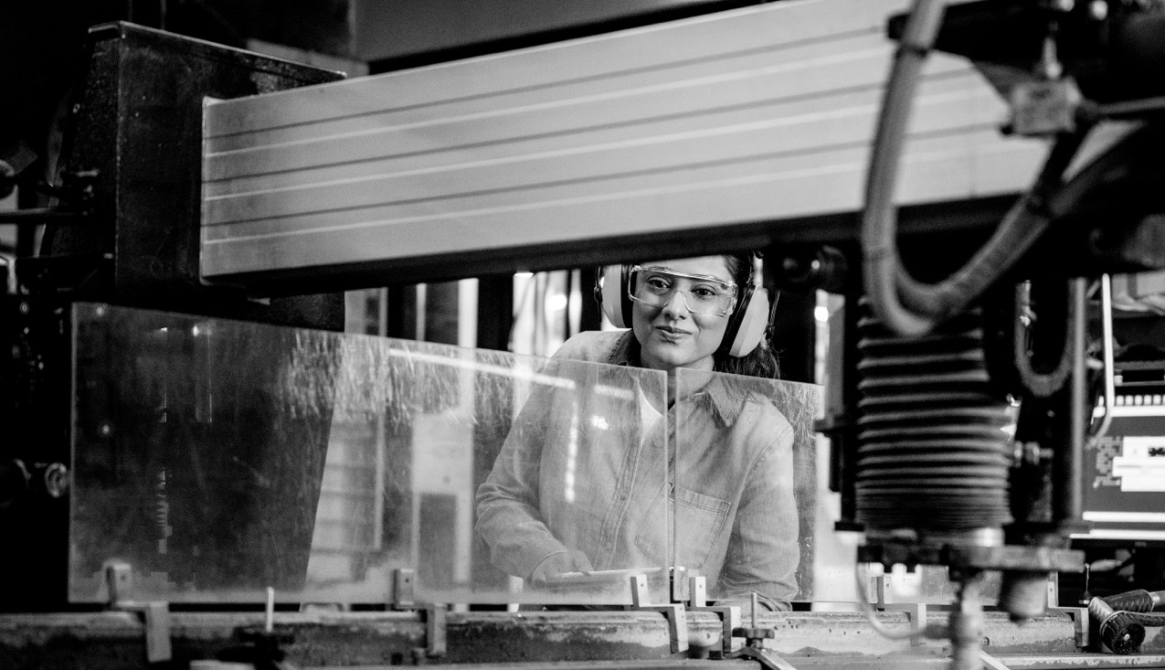

Executive Summary
Ohio’s manufacturing sector faces a growing technician shortage — not because interest is lacking, but because students, workers, and career influencers lack clear understanding, connection, and timely exposure to technician career pathways.
This research study examines findings from a 2025 statewide research initiative done by JobsOhio in partnership with Ohio Excel, surveying 1,700+ respondents, including high school students and their parents, counselors, emerging workforce participants, and current technicians and operators. To ensure consistency, all respondents were provided the same definition of a “technician”
— a skilled role focused on installing,
maintaining, troubleshooting, and repairing complex manufacturing equipment, typically requiring postsecondary training rather than a
four-year degree.
The research reveals a critical insight: the technician pipeline challenge is not a motivation problem — it is an information, messaging, and timing problem.
By clarifying technician roles, better aligning career messaging, increasing hands-on exposure, and engaging parents and counselors earlier, manufacturers can take meaningful steps to strengthen and sustain the technician workforce.
JOBS OHIO: CLOSING THE TECHNICIAN GAP

Slide 3
Research Scope
& Sample
To understand how perceptions of technician careers evolve across the education-to-workforce journey, researchers surveyed:
415
16
415
High School
Students
High School Counselors
Parents
490
400
Emerging Workforce
(Students in 2-year Degree or Certification Programs)
Current Technicians and Operators
1,700+ Respondents
TOTAL:
The study explored perceptions of manufacturing, career interest, exposure levels, motivators, and decision timing.
JOBS OHIO: CLOSING THE TECHNICIAN GAP

Slide 4
Findings
FINDING 1:
Interest exists — perception is not the core barrier
Across audiences, technician careers are viewed positively by:
70% of high school students,
73% of emerging workforce participants
76% of parents reporting favorable perceptions of technician roles.
Most respondents agree that manufacturing offers stronger career opportunities than people assume, indicating that reputation is no longer
the primary challenge.
However, positive perception alone does not translate into career pursuit — signaling a deeper issue around clarity and relevance, not image.
FINDING 2:
Internal Mobility Alone Won’t Solve the Pipeline Gap
While operators might appear to be the logical pipeline into technician roles, the data
shows limitations:
Only 54% of operators report job satisfaction, compared to 72% of technicians.
45% of operators believe technician training costs more than it’s worth.
Only 33% of current operators plan to train for technician roles
Many underestimate training length and overestimate barriers to entry.
Most respondents agree that manufacturing offers stronger career opportunities than people assume, indicating that reputation is no longer
the primary challenge.
However, positive perception alone does not translate into career pursuit — signaling a deeper issue around clarity and relevance, not image.
JOBS OHIO: CLOSING THE TECHNICIAN GAP

Slide 5
Findings
FINDING 3:
Clarity Dramatically Increases Career Interest
When respondents were shown realistic technician job descriptions:
71% of high school students
95% of emerging workforce participants reported increased interest.
The most common question across audiences:
Perceptions shifted from viewing technician work as “factory labor” to seeing it as dynamic, high-tech, and problem-solving–driven.
This signals a need for more tangible, real-world storytelling that makes technician careers understandable and relatable across all audiences
“
What does a day in the life actually look like?
“
FINDING 4:
Career Alignment Matters More Than “Hands-On” Messaging
Students most strongly identify with strengths in:
TECH
SCIENCE
MATH
Yet only 18% say “working with my hands” best describes them.
This highlights a messaging mismatch: technician careers align strongly with students’ interests in technology, problem-solving, and impact, but outreach often frames the work in manual or trade-oriented language that fails to resonate.
Effective messaging should highlight technical problem-solving, innovation, career mobility, stability, purpose, and high-tech identity — not just job tasks.
JOBS OHIO: CLOSING THE TECHNICIAN GAP

Slide 6

Findings
FINDING 5:
Exposure Is a Major Missed Opportunity
Hands-on exposure is one of the most influential factors in shaping interest — yet many students lack access:
One-third of students surveyed had no exposure to manufacturing experiences.
73% of students and 78% of parents say real-world experiences influence career decisions.
37% of the emerging workforce had not heard of training programs at all.
When exposure does occur — through plant tours, Manufacturing Days, or hands-on labs — it significantly increases awareness, confidence,
and interest.
THE TAKEWAY:
Conversion moments matter more than awareness campaigns.
JOBS OHIO: CLOSING THE TECHNICIAN GAP
PG 6
JOBS OHIO WHITE PAPER

Slide 7

Findings
FINDING 6:
Career Decisions Are Happening Earlier
Than Employers Realize
Older generations typically explored careers later:
  41% of current technicians said exploration started in 12th grade, and 53% made their
  final decision after graduation.
  Only 1% of current technicians began exploring careers before high school.
Current students being career exploration earlier:
  42% of students decide on career direction before 9th grade
  Students of color and female students plan earlier and more intentionally than their peers
Family, teachers, and counselors exert far more influence than social media or advertising
Manufacturers need to engage earlier through credible human influencers and real-world relationships, as social media alone is far less influential than often assumed.
JOBS OHIO: CLOSING THE TECHNICIAN GAP
PG 7
JOBS OHIO WHITE PAPER

Slide 8
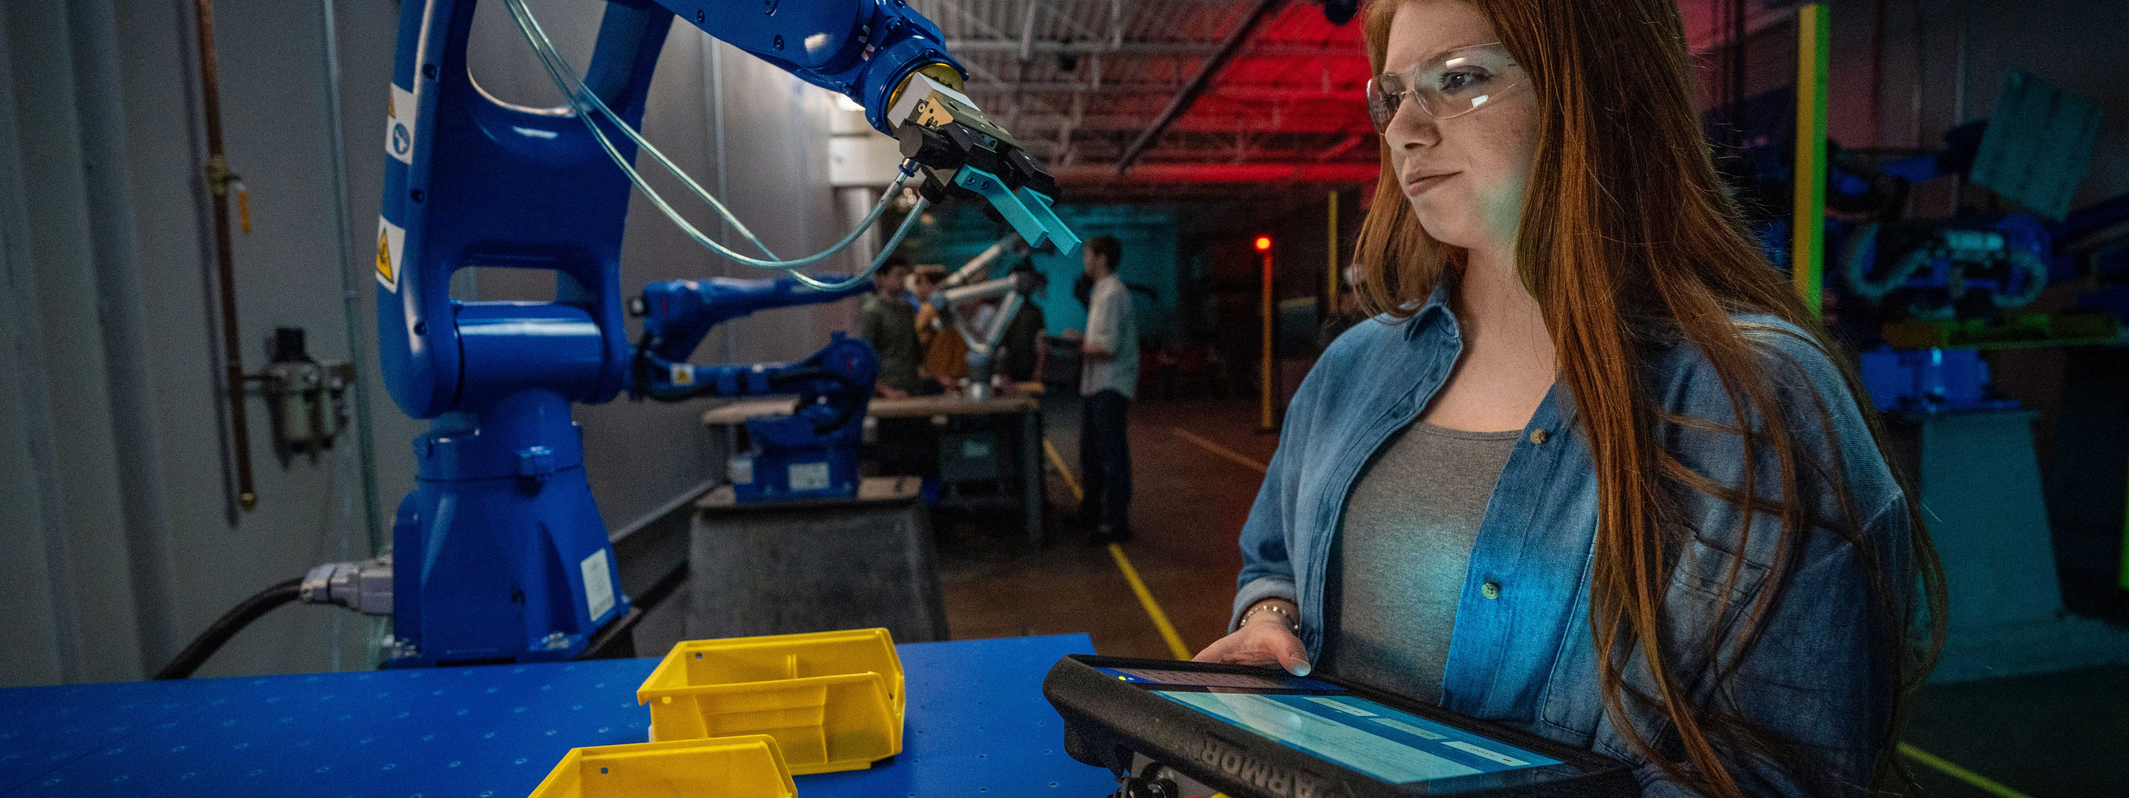
Findings
FINDING 7:
Advocacy Is the Hidden Bottleneck
Nearly everyone in the industry knows someone in manufacturing:
98% of technicians and operators have a personal connection to the field
72% of technicians report job satisfaction
Yet only 8% actively recommend the career
Nearly 60% remain neutral
This does not reflect dissatisfaction — it reflects a confidence and communication gap.
Workers often struggle to explain:
Career growth pathways
Workload realities
Long-term earning potential
Why the career is worth recommending
This represents a major opportunity to equip employees as informed, confident career ambassadors.
JOBS OHIO: CLOSING THE TECHNICIAN GAP

Slide 9

Key Implications for Manufacturers
1
LEAD WITH TECHNOLOGY, NOT MANUAL LABOR
Students define “hands-on” as automation, systems, robotics, and advanced tools — not physical labor alone. Technician outreach should reflect this reality.
FOCUS ON PARENTS AND COUNSELORS
Parents and counselors are the most influential decision-makers, yet many lack clear context on technician career pathways. Simple, confident guidance can shift outcomes.
FRAME TECHNICIAN ROLES AS LIFELONG CAREERS
Younger generations value stability, flexibility, and transferable skills. Emphasizing that 80%+ of technician skills transfer across industries reframes the role as a long-term career platform, not a single job.
PRIORITIZE EARLY, REAL-WORLD EXPOSURE
Move beyond awareness alone into experience-based engagement — plant visits, mentorship, labs, and job shadowing.
UPDATE OUTREACH STRATEGIES THAT NO LONGER
DRIVE IMPACT
The research indicates manufacturers should:
Evolve past outdated perception-correction efforts
Avoid leading with benefits alone — benefits are expected,
not motivating
Reduce reliance on social media as a career influence tool,
prioritizing real relationships instead
2
3
4
5
JOBS OHIO: CLOSING THE TECHNICIAN GAP

Slide 10
Conclusion
THE TECHNICIAN GAP IS SOLVABLE
Ohio’s technician shortage is not a problem of interest — it is a challenge of clarity, connection, and timing.
The solution does not require a silver bullet. It requires earlier engagement, clearer storytelling, stronger exposure, and more confident career advocacy — led by employers themselves.
Manufacturers already have the tools to shift outcomes: their people, their facilities, their partnerships, and their willingness to engage earlier and more visibly.
By acting now, industry leaders can build a stronger, more sustainable technician pipeline — and secure the future of Ohio manufacturing.

Slide 11


