Slide 1
Annual Study in Ethics for the Directors and Officers
Claudia S. Herrington Esq., CCEP
September 30, 2019

Slide 2
Overview
A. Conflicts of Interest, Gifts, and Whistleblower Policies
B. Lobbying Activities
C. Reporting, Standards of Conduct & Governance

Slide 3
What is a Financial Interest?
A financial ownership interest or investment interest between you or your family and any person or entity, such as:
An equity interest in a non-publicly traded entity;
An equity interest of 1% or more of any publicly-traded company;
Remuneration of over $10,000 in the preceding year from an entity other than JobsOhio;
Income from intellectual property rights.
It is usually not your JO salary, pension, mutual funds, or bank account.

Slide 4
What is a Fiduciary Interest?
An obligation to act in the best interests
(financial success) of another, such as
membership on a Board or management
role in a company.
Family = spouse or domestic partner, dependent children or other individuals claimed as dependents for tax purposes.

Slide 5
Potential Conflicts of Interest - Disclosure
Financial Disclosure Statement (FDS)
Per R.C. 187.03(B)(2): Directors and employees with significant administrative, supervisory, contracting, or investment authority must file.
FDS due to the Ohio Ethics Commission usually on/before April 15th.
There are 55 current and former Directors and employees that must file.

Slide 6
Gifts – JobsOhio has 2 Policies
Employees must abide by the law just like any other private entity that is doing or seeking to do business with a public official.

Slide 7
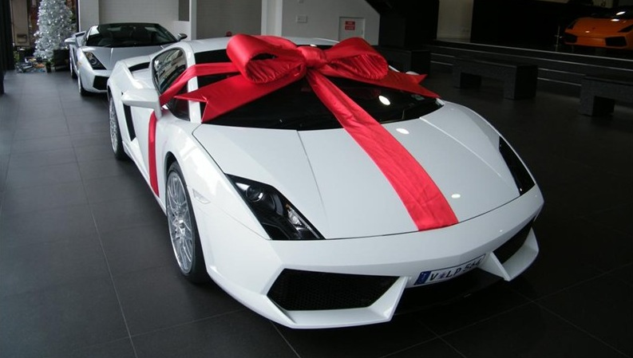
Gift Policy
Gift = ANYTHING of value that holds no expectation of receiving anything in return.
Applies to gifts received by/for JobsOhio Employees.
”Business Associate” = person/entity, other than JO colleagues, with whom the employee interacts on a professional basis.
Employee may not solicit anything of value that could reasonably be expected to influence the employee in the performance of their duties.

Slide 8
Gift Policy (cont’d)
Acceptance of gifts is generally prohibited unless the following steps are taken:
They are given without an express or implied understanding of obligation;
They do not violate law;
They do not place the employee in a compromising position; and
They are not of such a character to create the impression of favoritism
No cash or cash equivalent (exception = one gift card $35 or less)
Attempts to circumvent the gift policy may result in disciplinary action
Cannot accept a gift under the guise of a “purchase”
Understand the cumulative cost of the gift.

Slide 9
Corporate Gift Giving
Applies to gifts given by JobsOhio employees
Gift = ANYTHING of value that holds no expectation of receiving anything in return. (e.g. travel expenses, tickets to sporting events, offers of future employment, better loan rate)
“Business Associate” = Same as in Gift Policy
Promotion Items = OK
Prohibitions:
With limited exception, no gifts to vendors/consultants

Slide 10
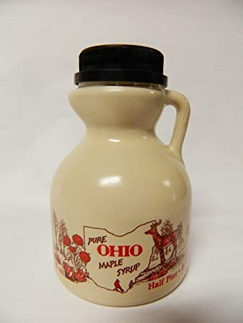
Corporate Gift Giving (cont’d) – Permissible Gift Giving
Small gift or token of esteem or gratitude
Relevant connection to or made in Ohio
Give openly and transparently
Properly recorded in giver’s books
Provide only to reflect esteem or gratitude
Permitted under local law

Slide 11
Corporate Gift Giving (cont’d) – Permissible Amounts
$25 = Consultants
<$35 = No prior approval
$35 – $100 = Supervisor approval
$100 – $200 = Leadership Team approval
>$200 = President and CIO approval
In Yellow – DOC approval if to a Foreign National
All gifts >$35 – Corporate Gift Giving Form
If Business Associate cannot accept a gift, do not offer it to his/her staff or family
Cannot circumvent or exceed the policy by paying for it yourself !!!

Slide 12
Whistleblower
Expectations
Reporting
Retaliation

Slide 13
Overview
A. Conflicts of Interest, Gifts, and Whistleblower Policies
B. Lobbying Activities
C. Reporting, Standards of Conduct & Governance

Slide 14
Lobbying
Overview
JobsOhio is an Executive Agency and a reportable entity.
If an Executive Agency Lobbyist (EAL) purchases any gift or food/beverage for a JobsOhio reportable agent, the EAL must report it.
JobsOhio employs 2 EALs. If JobsOhio staff pays expenses for a legislator or reportable staff person, it must track and report it
Recordkeeping
As the employer of EAL, JobsOhio must report and keep a record of all expenditures on legislators and/or reportable staff persons.
EALs must separately keep a record of expenditures and report for legislators and reportable staff persons.
JobsOhio and the EALs file Activity & Expenditure Reports 3 times per year with the Joint Legislative Executive Committee
A record of all expenditures must be retained for 2 calendar years after the expenditure was made.

Slide 15
Overview
A. Conflicts of Interest, Gifts, and Whistleblower Policies
B. Lobbying Activities
C. Reporting, Standards of Conduct & Governance

Slide 16
Reporting
IRS Form 990 Required Disclosure
Family/business relationships between Board Members
Conflicts of Interest by Directors, Officers, and key employees
Acknowledgement of ethics, conflict of interest and whistleblower policies and corporate governance practices

Slide 17
Standards of Conduct
In performing our duties for the Corporation, each member of the Board of Directors and all employees shall strive for the highest ethical conduct and fundamental honesty.
We must:
perform our duties at all times in good faith,
in a manner we reasonably believe to be in the best interest of JobsOhio, or not opposed to,
with the care that an ordinarily prudent person in a like position would use under similar circumstances, and
Maintain the confidentiality of all information regarding the activities of JobsOhio and its customers, unless the disclosure of the information has been authorized.

Slide 18
Standards of Conduct (cont’d)
We must not:
Deceive, defraud, or mislead JobsOhio board members, our associates, or those with whom JobsOhio has business or other relationships.
Misrepresent JobsOhio in any negotiations, dealings, contracts, or agreements.
Divulge or release any information of a confidential or proprietary nature relating to JobsOhio’s plans, mission, or operational activities without appropriate approval.
Obtain, or seek to obtain, a personal advantage or benefit due to relationships established by my position with JobsOhio or by any use of the JobsOhio name.
Withhold my best efforts to perform my duties to acceptable standards.
Engage in unethical business practices of any type.
Use JobsOhio property, financial resources, or services of JobsOhio personnel for my personal benefit.
Violate any applicable laws or ordinances.

Slide 19
Governance – Duties of the Directors
Set the mission and direction for JobsOhio
Decision making
Oversight
Mentorship
Duty of care – Exercise the care an ordinarily prudent person in a like position would use under similar circumstances.
Duty of loyalty – Act in good faith, in a manner he/she reasonably believes to be in or not opposed to the best interests of the corporation.
When operating as a board, JobsOhio is 1st loyalty.
Board must act as a whole. An individual director has no authority to take any action unless authorized by the Board.
Need a quorum at meetings.

Slide 20
Governance - Reliance
State corporation law provides protection for a Directors’ reliance on –
Officers and employees of JobsOhio
Legal Counsel
Public Accountants
Consultants or other professionals
Committees of directors

Slide 21
Governance - Duty of Management & Employees
Provide input to help the board give direction.
Execute direction given by the Board through the appropriate use of authority and observing set limits.
Duty of care – Exercise the care an ordinarily prudent person in a like position would use under similar circumstances.
Duty of loyalty – Act in good faith, in a manner he/she reasonably believes to be in the best interest of the corporation. [higher duty than that of directors]

Slide 22
Governance - Integrity & Ethics
The JobsOhio Board of Directors promotes a culture of integrity and ethics
Accountability
Transparency
Responsible business practices

Slide 23
QUESTIONS

